Slide 1
School Inclusion Team
Patricia Kenna- Lead Clinical Practitioner
Stacey Edmead – Senior Systemic Practitioner
Naresh Chall- Family Practitioner
Thais Wizenberg- Family Practitioner
Mollie Shomali– Family Practitioner
Angharad Rees- Family Practitioner (Ukrainian families)
For further information contact pkenna@westminster.gov.uk or sedmead@westminster.gov.uk
Notes:
Thais – intro and recap 30 mins

Slide 2

Trauma informed classroom recap
26th March 2024
Notes:
Link to higher risk of school exclusion and attendance

Slide 3
Group agreement
Safe space: for everyone to respect confidentiality
Self care: to be aware of our wellbeing when thinking about trauma
Support: each other by showing kindness and feel free to ask questions

Slide 4
Learning aims
Thinking about trauma informed approaches in school
What may be happening for the child?
(and making them feel unsafe)
Ideas that may help a child feel safe and ready to learn
What we need and bring: Reflecting on our roles

Slide 5
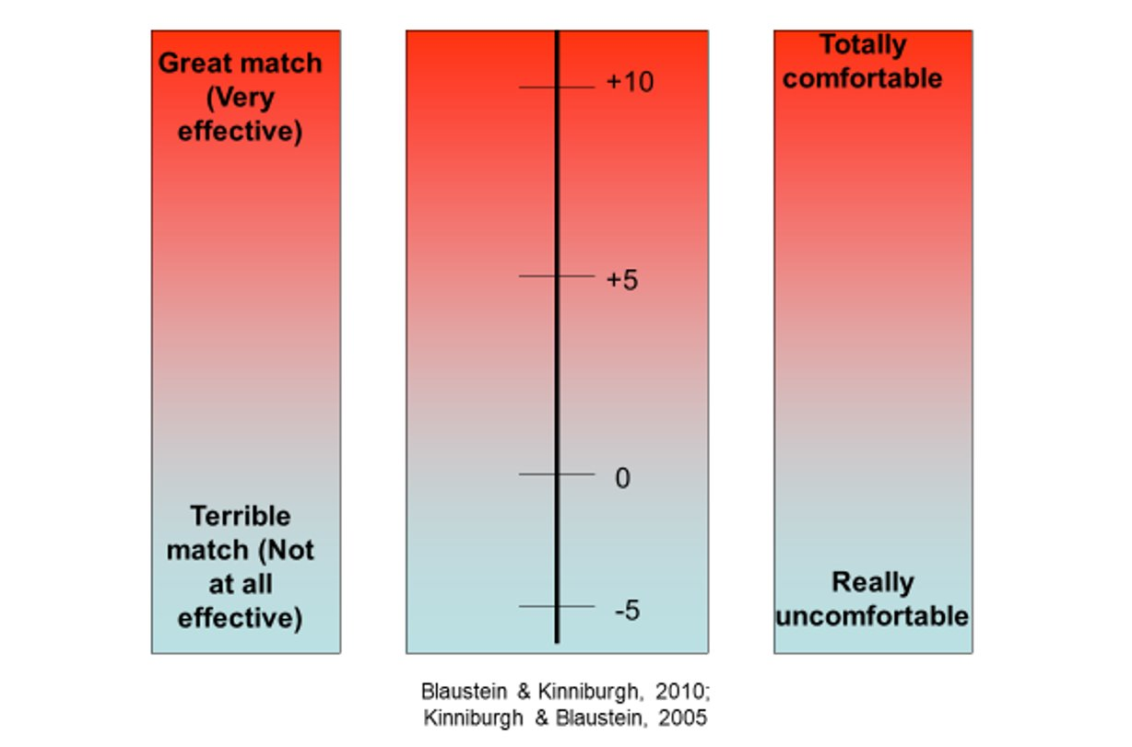
Where is your energy at right now?
Notes:
Welcome & introduction
Ice breaker activity- Where are you now on the scale?
- you look happy & full of energy/ you walked in very calmly
- Feedback- verbal or hand signal
"Your energy needs to match the activity"

Slide 6
“Trauma is not what happens to you, it's what happens inside you as a result of what happened to you.”
-Dr Gabor Mate
Notes:
YES

Slide 7
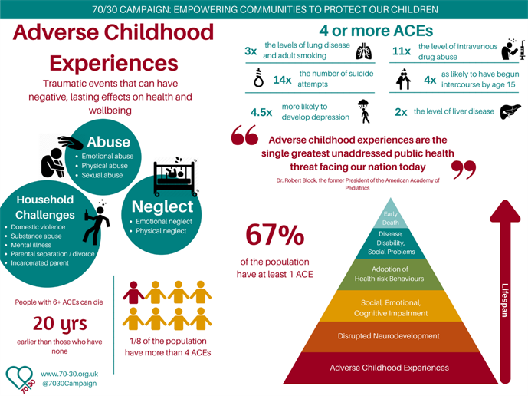
Adverse childhood experiences (ACES)
Notes:
Adults didn’t keep me safe – no one comes- can’t trust
Higher needs when have are both neurodiverse and experienced trauma
Racism, war, bereavement as well as long term complex trauma domestic violence, emotional abuse, neglect

Slide 8
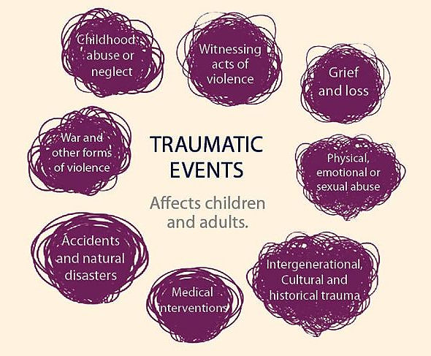
Covid informed Trauma
Racism
Neurodiversity
Youth violence
Social Deprivation / Poverty Informed Trauma
Vicarious Trauma

Slide 9
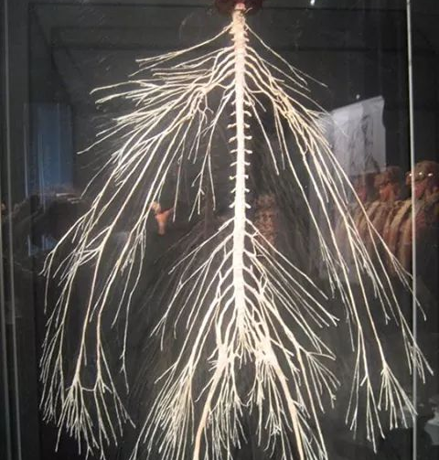
Human Stress Response
(Fight/Flight/Freeze/Appease)
Human beings are biologically primed for survival
Perception is more important than reality
Trauma is not the event itself: rather trauma resides in the nervous system…
Notes:
Amygdala-reptilian brain – instinctual – basic bodily functions: adrenaline/cortisol release to run
Limbic- emotional/feelings
Neocortex- rational thinking brain
Domestic violence- shouting
While surviving not learning other things
Behind emotionally and in learning

Slide 10
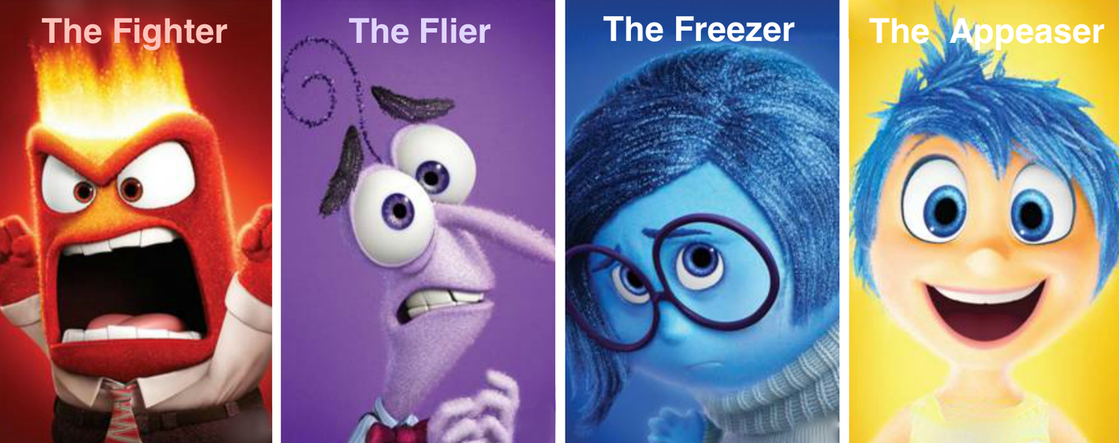
Human Stress Response
Human Stress Response
Fight
Flight
Freeze
Appease
Escalate Defense or Offense
Avoid the Threat
Paralyzed by shock or fear
Tend and Befriend
Confront the Threat
Run or Escape
Retreat within, Collapse or Dissociate
Pacify or Placate (someone)
Notes:
Home with conflict- Dysregulated child may have been triggered by seeing an argument
Whole class being shouted at for not lining up
Shouting triggers

Slide 11

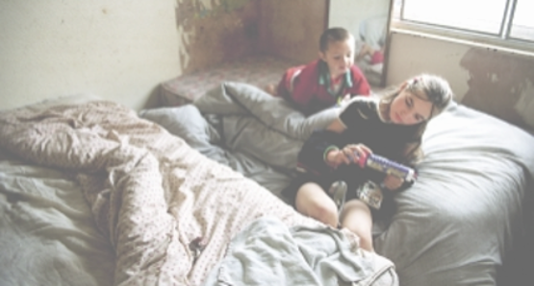

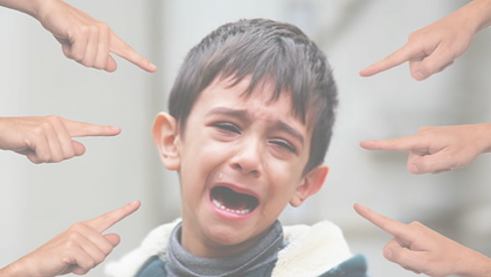
What is wrong with this child?
What is happening for this child?
Notes:
Thais
Keep in mind a student in your class for the next exercise
Be curious about what’s happening for the child
Internal
External

Slide 12
Thinking about: Fight/Flight/Freeze/Appease
We might see
Not following instructions
Refusing to engage with the lesson
Not listening
Interrupting
Talking back
Attention seeking/attention needing
Distracting others
Swearing/shouting
Cut off/closed down/withdrawn
Fidgeting
Inappropriate noises/gestures

Slide 13
Be curious about…
Covid informed Trauma
Racism
Neurodiversity
Youth violence
Social Deprivation / Poverty Informed Trauma
Vicarious Trauma

Slide 14
What could they be feeling?
Feeling unsafe
Social and emotional development
Feeling misunderstood
It’s unfair
Shame/embarrassment/blame
Unmet physical needs- hungry/ tired/ thirsty/hot/cold etc
Unmet additional needs
Making a mistake, fear of failure
Change, e.g. new teacher, mini transitions during school day
Not being noticed/heard
Unwanted attention e.g being laughed at
Threat of exclusion
Time of day/year
Notes:
Threat of exclusion. Link to survival
Even response to praise – embarrassment

Slide 15
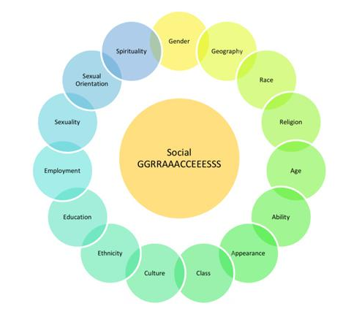
How do we see the world?
Family scripts
Similarities
Differences

Slide 16
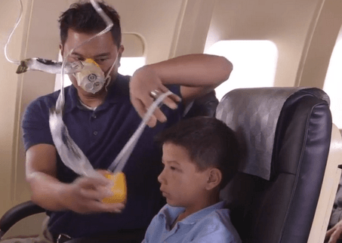
Self care in school
A dysregulated child/young person needs a regulated adult
How’s your energy level and what might you need?
What helps you feel okay at the end of the day?
What support is available or what you need?
What opportunities are there for sharing ideas and concerns about students with each other?
What external services are available for support?
Notes:
How feel when you see arguing/shouting in
Not taking it personally – when calm
Not taking it home
Offloading
Again, oxygen mask.. Its about a regulated adult can support regulated child

Slide 17

In school: What’s happening for you?
What responses are triggered to what you see?
What might you be thinking and feeling and why?
What might influence your response?
Notes:
Students who stay in your head

Slide 18
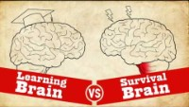
Understanding trauma: learning brain vs survival brain
Notes:
Start video at 0:23
Total around 4:30
Day 3

Slide 19
When children feel safe they can access their thinking brain and get ready to learn
Relationships
Safe spaces
Energy regulation
-What energy is needed and when?
-Predictability
“Curious not furious”
Notes:
CONTROL
If not feeling safe won’t be ready to learn
Reminder – fight flight freeze what we mean when we talk about arousal

Slide 20
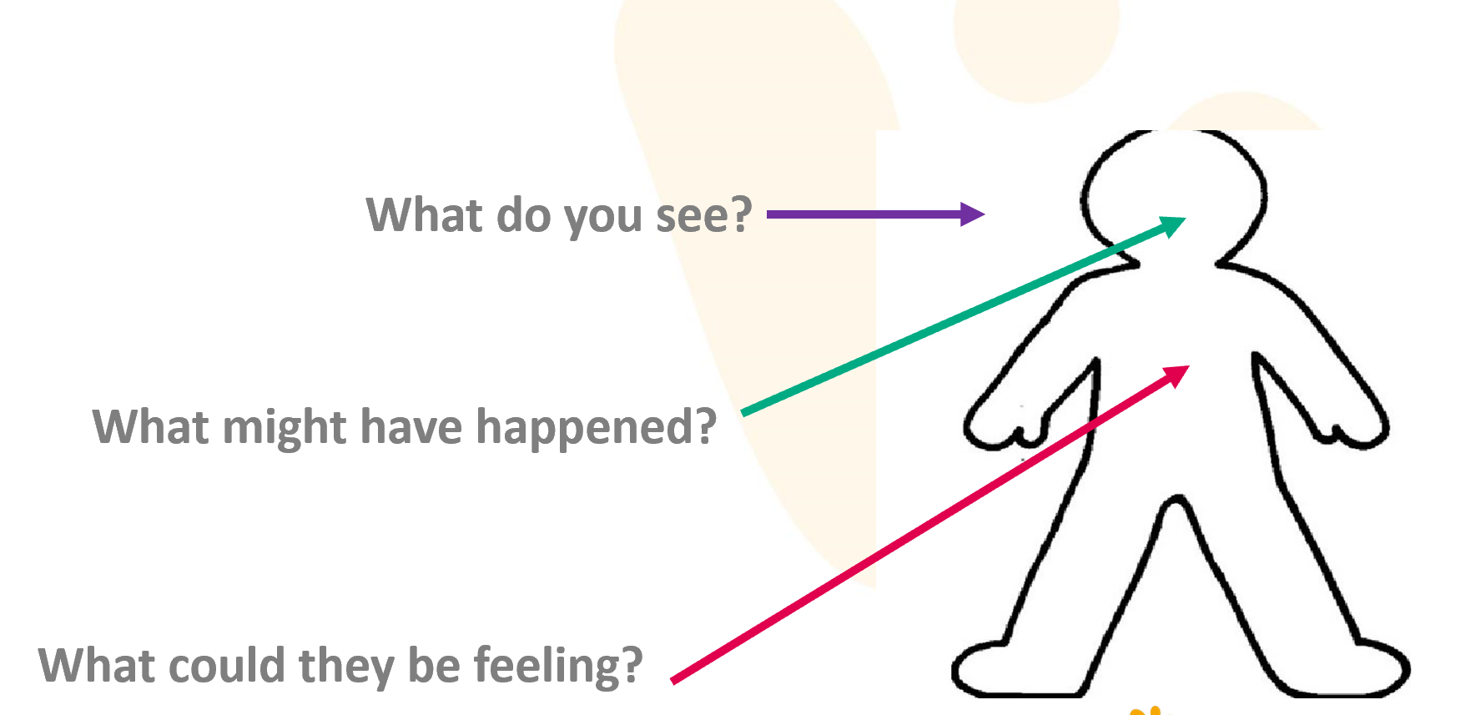
Strategies: building trusting relationships
Reassurance and validation
Praise and opportunities to achieve
Validate feelings without condoning behaviour e.g “it seems like/I wonder if you’re feeling…..”
Attunement is the foundation for helping children learn to regulate
Rupture and repair
Curiosity
Engaging with child’s interests
Remember it’s not personal
Communication with parents
"Connection before correction”
Notes:
Considering communication, tone of voice and body language

Slide 21
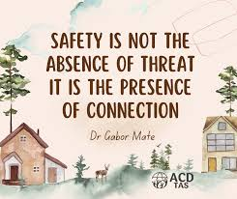
How do you create safe spaces in school?
What does this look like?
Child
Consider the environment e.g the meaning of the room, sensory needs of child, items in the room (can they harm themselves or others).
Can this be inside the classroom? E.g library corner
Teacher
Other staff support
Seating arrangement of the students
Staff reflection and peer supervision
Notes:
Teachers: Feeling Safe and staying regulated E.g Student in your eyelin/where you sit them, Other members of staff for support space for reflection
Consider as adult what may look like to child for e.g if blocking door, how many staff members, which staff members and relationship to child e.g SLT
If child is refusing to move- if they and others are safe do they need to be moved?
Reflection space consider where is best to have difficult conversations? With children and between staff
For example: sensory room, calming down room? standing outside the door (with supervision), reception area, school pets
Transition- contact/touch may be more triggering for these children.

Slide 22
Scenario in the classroom
what does the child need?
A child shouts out
Scenario 1
Scenario 2
Child is given a warning
(May feel upset, it’s unfair)
Teacher acknowledges the child
Given responsibility
Safety corner
Survival mode is triggered
Opportunity to try again
Behaviour escalates
Behaviour reduces/changes
Notes:
Need to be in thinking brain

Slide 23
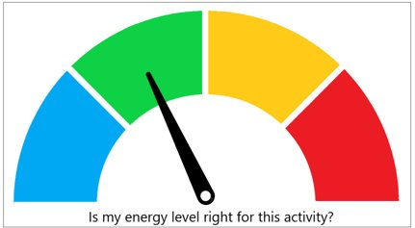
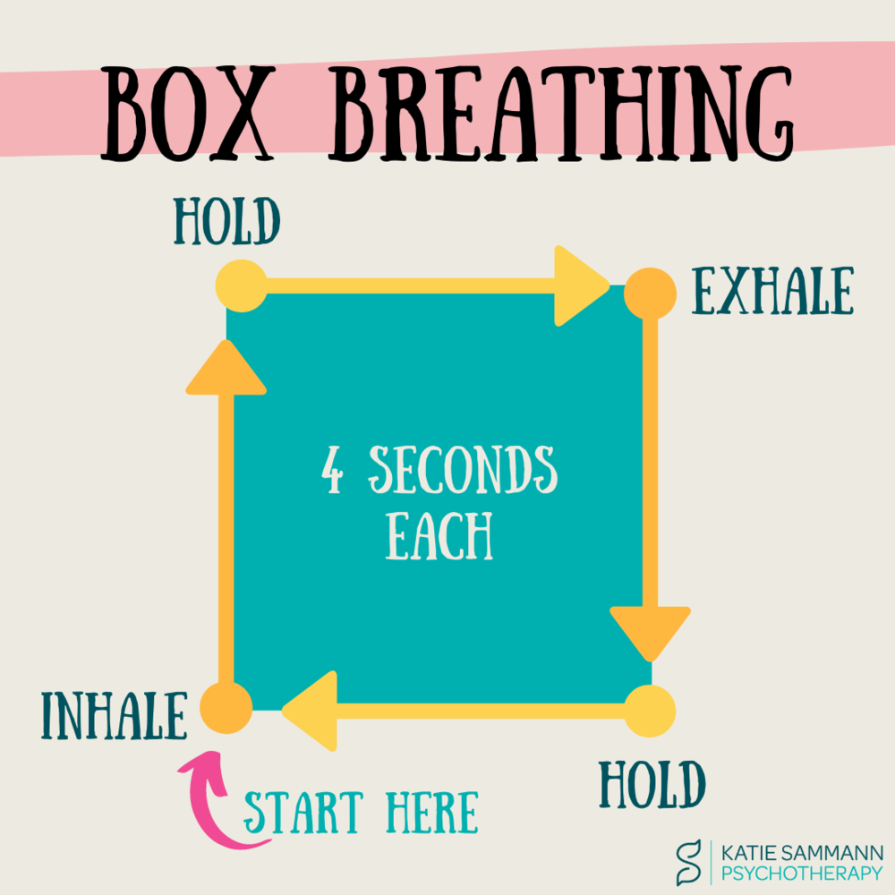
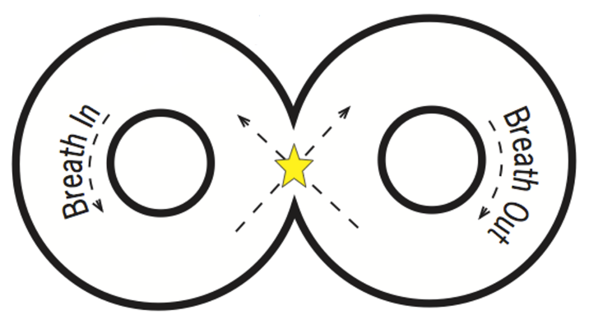
Strategies: energy regulation
Down Regulation: activities that help a child lower arousal
Sensory toys: tangle, slime, touching sand
Breathing: figure of 8, box breathing, blowing out a candle
Music
Drawing/writing/scribbling
Mindfulness/ safe space imagery
Self hug
Muscle relaxation: tension and release, body scan, stress balls, stretching, pushing against a wall
Notes:
Thais – 15 mins
Modelling strategies / self talk
Refer back to getting children into their thinking brain

Slide 24
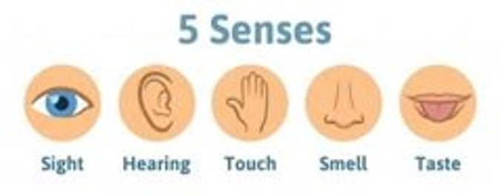
Strategies: energy regulation
Up regulation: activities that help a child increase arousal, in service of engaging with and connecting to the environment Playing “I spy”
Sensory toys: tangle, slime, touching sand
Star jumps/movement break
Being given tasks/special jobs
Yoga
5 senses
Music
Safe place imagery: guided mindfulness exercise or drawing
Notes:
Think about yourselves as well

Slide 25
Questions/Comments
Notes:
5 mins end
Resources to send:
SPA tel number
Link for survey monkey…

Slide 26


Classroom
strategies

Slide 27
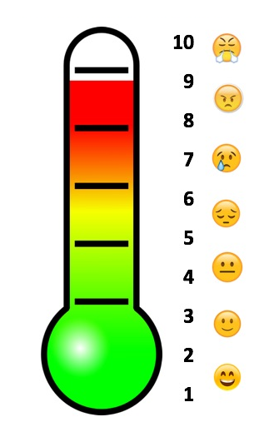
Predictability
Routines and rituals
Hand shakes / greetings
Feelings/energy check in
Settling task e.g music, reading, drawing, “soft start”
Visuals support with:
Transition within the classroom and the playground
Breaking down tasks
First and then
Choices and consequences
Prompting / reminders
Timers
Notes:
Thais Refer back to getting children into their thinking brain

Slide 28
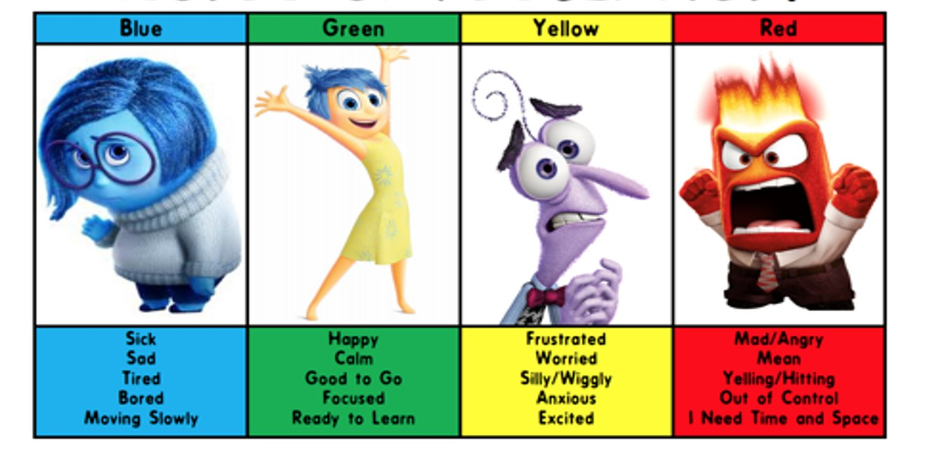
Emotional literacy
Self reflection/awareness- naming feelings
Personal strategies
Identity: superpowers/self image
Modelling self reflection
Validate feelings without condoning behaviour e.g “it seems like/I wonder if you’re feeling…..”
Notes:
Need to be in thinking brain!
Consider facial expressions and body language help better identify emotions
Work through scenarios when things went well/didn’t go well: what could’ve been done differently? What skills will be needed?
Examples/evidence when giving praise and when describing why adult wonders about their feelings/zones
This is complex!

Slide 29
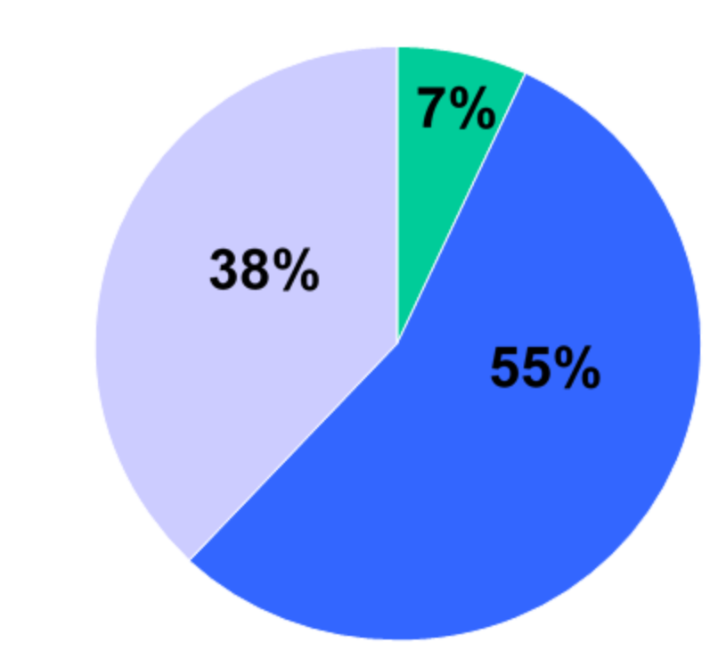
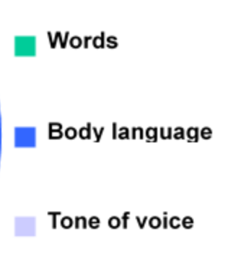
Communication
Remember: The PERCEPTION of tone of voice and body language is more important than reality
Consider: Has the child’s survival mode been activated (nervous system)
Notes:
Stacey Reminder: significance of tone of voice and body language
Shouting-survival response
Internal working model
Compliment-”you’re lying”

Slide 30
Strategies: Communication
Possible trigger phrases:
“This behaviour is unacceptable!”
“What would you mum/dad say about this”
“You’re being rude”
‘’You’re telling lies’’
“You’re getting on my nerves”
Reframe:
“I want to keep you/everyone safe”
“Everyone wants you to try your best”
“You’re speaking in a rude manner”
“Help me understand what happened”
“ I need some time to think/to finish my work”
Notes:
Shameful language

Slide 31
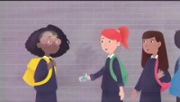
Childhood Trauma and the Brain: UK Trauma Council
Notes:
What we know is that secure relationships with trusted adults are the building blocks/foundation to helping children feel safe
5:11mins

